Slide 1
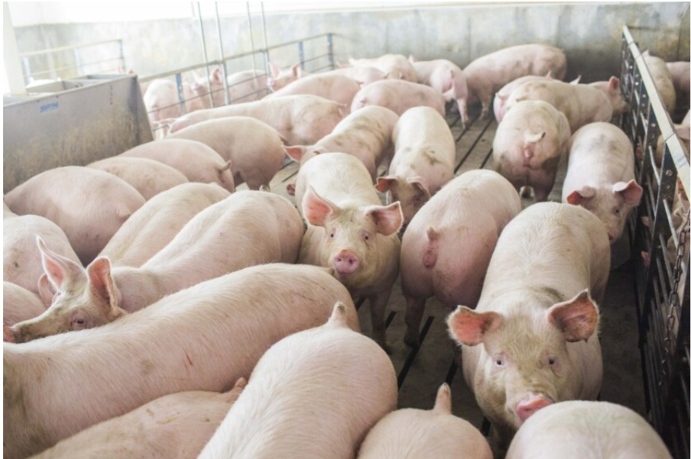
Analyzing Global Live Pigs Export Market Using Machine Learning Models
DSC680-T301 Applied Data Science (2251-1)
Project 2: Final Presentation
Author: Zemelak Goraga
Date: 10/19/2024
Instructor: Prof. Amirfarrokh Iranitalab

Slide 2
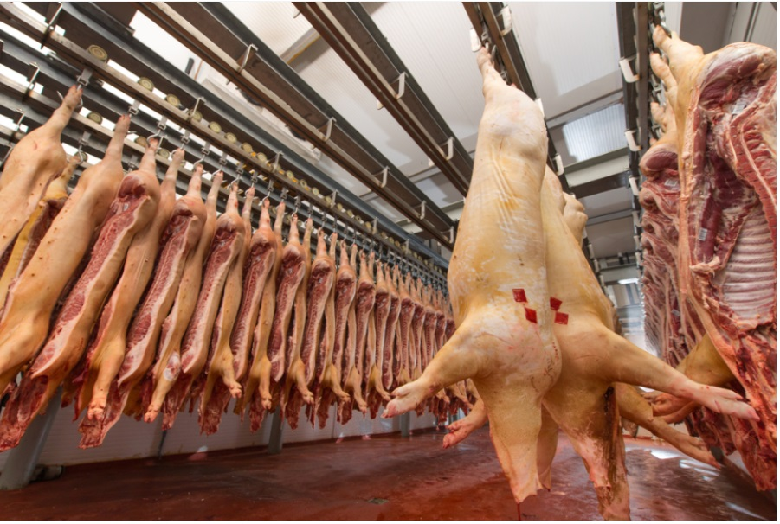
Introduction
The global live pigs export market plays a crucial role in food security and agricultural growth.
The market is influenced by economic conditions, trade policies, and consumer preferences.
Machine learning can be used to uncover patterns that are often missed by traditional analysis, helping stakeholders predict market performance more accurately

Slide 3
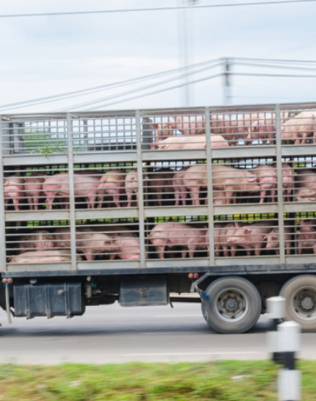
Scope of the Project
Used FAOSTAT dataset (1961-2013)
Key Variables: Export quantities (heads), values (USD), country, year
Global coverage of live pigs export

Slide 4
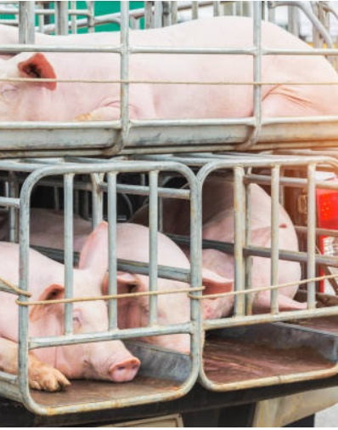
Business Problem
The live pigs export market faces challenges such as fluctuating demand, trade barriers, and inefficiencies.
Traditional analysis methods don’t fully capture these complexities.
This project seeks to fill that gap

Slide 5
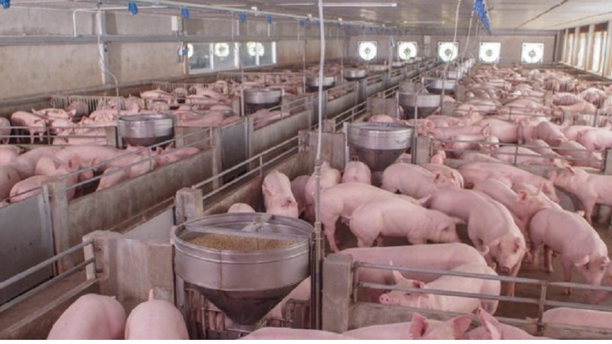
Research Questions
1. What are the trends in export quantities and values, and how do they correlate over time?
2. Which countries or periods show significant deviations in value-to-quantity ratios, highlighting inefficiencies or strategic advantages?
3. Can machine learning models cluster exporting countries based on similar export behaviors?
4. What patterns do association rules reveal about frequently occurring high export quantities and values?
5. How do export behaviors cluster based on multiple features, and can PCA effectively visualize these patterns?

Slide 6
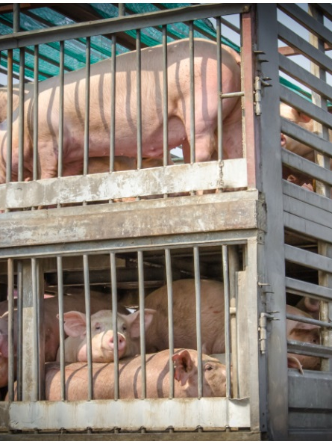
About the Dataset
Data Source: FAOSTAT dataset (1961-2013)
Key Variables: Export quantities (heads), values (USD), country, year
Scope: Global coverage of live pigs export

Slide 7
Methodology
Preprocessing:
Imputation of missing values
Feature engineering (value-to-quantity ratio)
Data normalization for consistent scaling
Exploratory Data Analysis (EDA):
Visualizations: Time series analysis and heatmaps
Correlation Analysis: Identified trends and key deviations
Identified Deviations: Found inefficiencies or strategic advantages
Machine Learning Models:
Model Development
K-means clustering for country segmentation
Association rule mining for pattern discovery
PCA for dimensionality reduction and cluster visualization
Model Evaluation:
Metrics Used
Silhouette scores for clustering evaluation
Lift, confidence metrics for association rule mining
Visualizations for model interpretation

Slide 8
Assumptions
The FAOSTAT dataset accurately reflects global live pigs export trends from 1961-2013.
Relationships between export quantities and values remain consistent over time.
The machine learning models selected were presumed appropriate for capturing underlying patterns in the data.

Slide 9
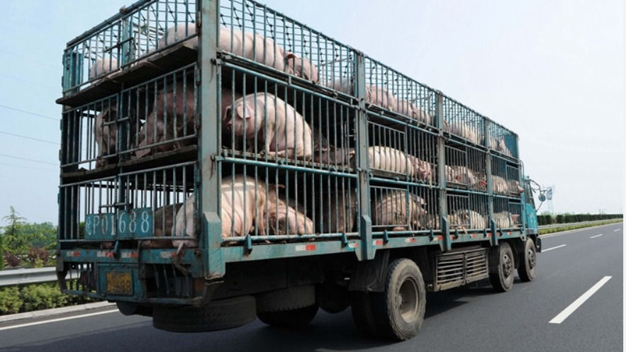
Ethical Concerns
Ethical considerations included ensuring data privacy, mitigating biases in machine learning models, and maintaining transparency.
Promoting data-driven insights responsibly ensures fairness and sustainability in global trade practices.

Slide 10
Results - Descriptive Analysis
Export Quantity Trends:
Mean export quantities varied from 305.4 heads (2008) to 723 heads (2012)
High variability in 1999 and 2000, reflecting uneven export performance
Export Value Trends:
Export values ranged from $189,600 (2010) to $642,100 (2007)
Significant fluctuations in performance among countries
Correlation Between Export Quantity & Value:
Moderate Correlation (0.66): Suggests economic value rises with export volumes, but other factors also play a role

Slide 11
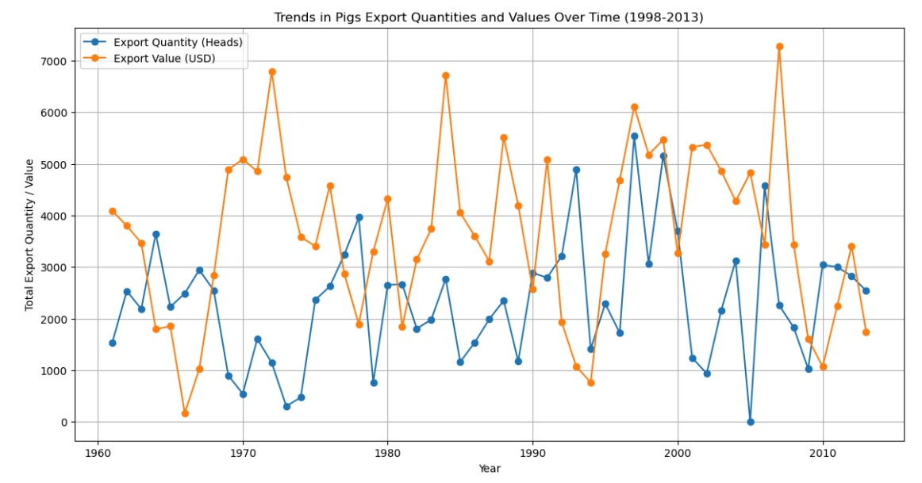
Trend Analysis:
Export Quantity (heads) and Export Value (US$)
Export quantities fluctuated between 305.4 heads (2008) and 723 heads (2012).
Export values varied from $189,600 (2010) to $642,100 (2007).
Variability across countries and periods indicated uneven export performance.

Slide 12
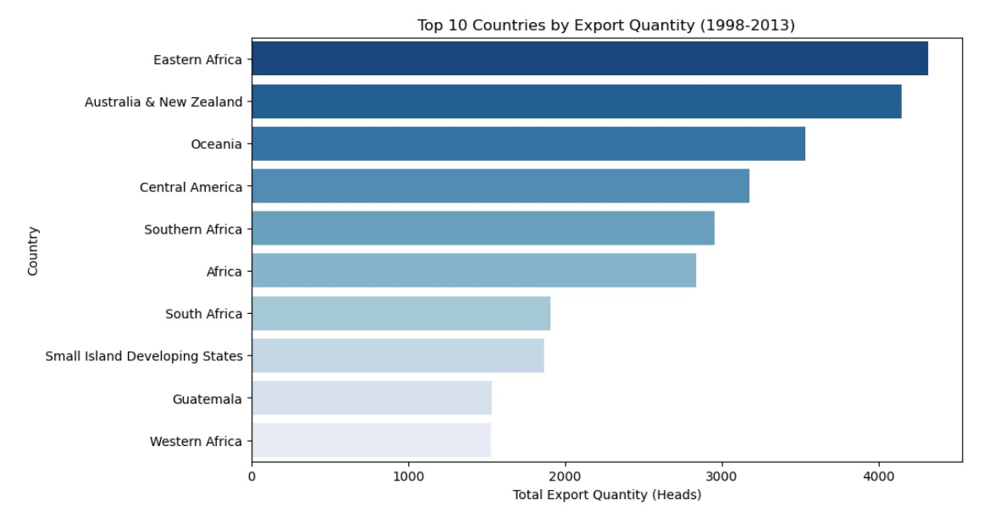
Country Comparison:
Top 10 countries by export quantity
Eastern Africa (4,318 heads) and Australia & New Zealand (4,150 heads) led the exports, followed by Oceania (3,534 heads).

Slide 13
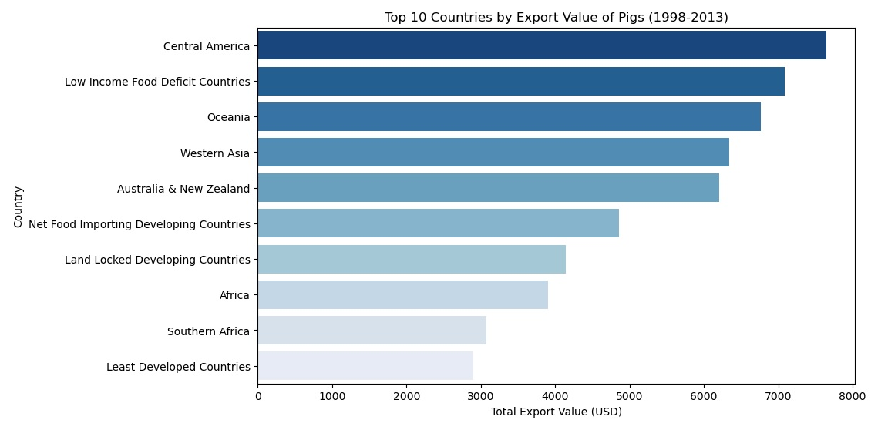
Country Comparison: Export Value (US$)
Top 10 countries by export Value
Central America led with $7,652,000, followed by Low Income Food Deficit Countries ($7,085,000) and Oceania ($6,767,000).

Slide 14
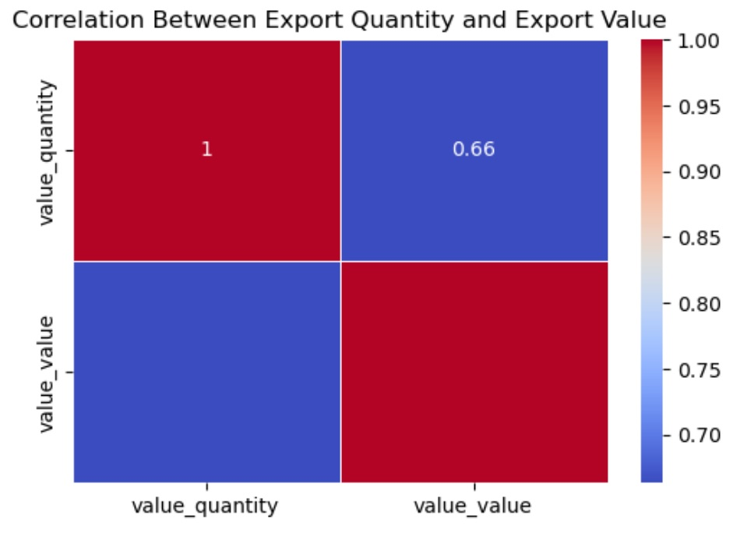
Correlations:
A correlation of 0.66 showed a moderate positive relationship between export quantities and values

Slide 15
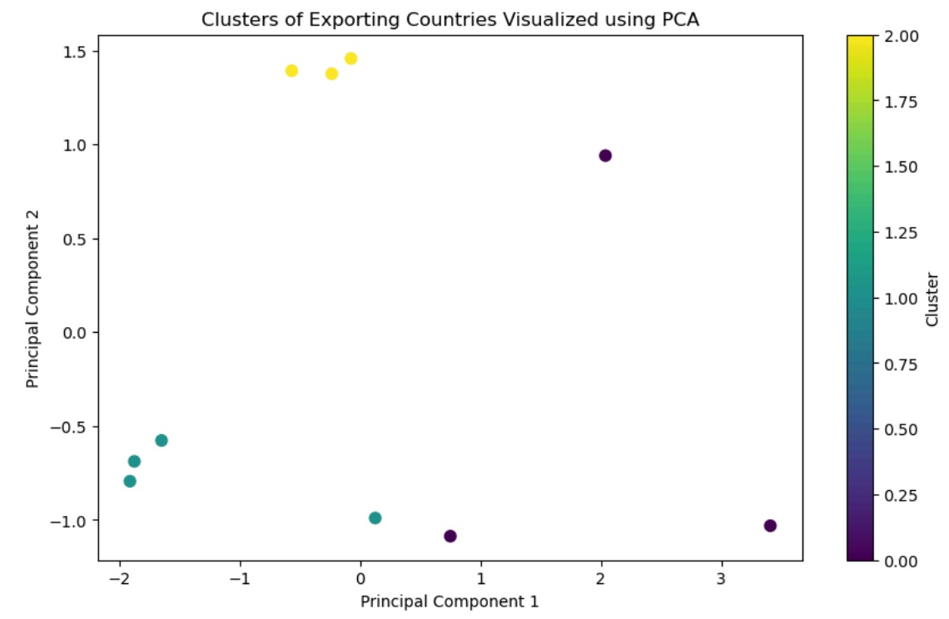
Clustering Analysis
Three Clusters Identified: Based on export behavior
Cluster 0: Value-driven exporters (e.g., Africa, Southern Africa)
Cluster 2: High-volume exporters (e.g., Australia & New Zealand)

Slide 16
Association Rules
Key Patterns: Export Value → Export Quantity (Confidence: 95%, Lift: 1.98)
Significance: Strong relationships between high export quantities and values

Slide 17
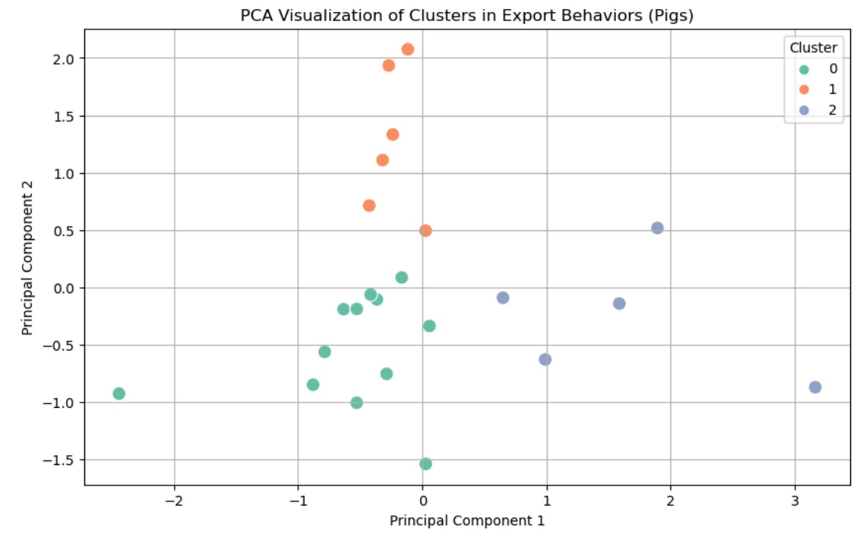
Principal Component Analysis (PCA)
PCA Insights: Clear visualization of export patterns, showing regional differences in export behavior (e.g., Africa vs. Australia)

Slide 18
Discussion
The analysis revealed fluctuations in both export quantities and values.
Significant deviations, like the Caribbean in 1984, suggest strategic advantages or inefficiencies.
Balanced ratios, such as Australia & New Zealand in 2007, reflect efficient trade practices.
K-means clustering grouped countries into three clusters, providing insights into their export behaviors.
Association Rules such as (Export Value) → (Export Quantity) demonstrate strong relationships between export quantities and values, offering practical guidance for improving export strategies.
PCA enabled visualization of export patterns, providing a clear understanding of how countries differ in their export behaviors.

Slide 19
Conclusions
Machine learning revealed key patterns in global live Pigs export
Data-driven strategies can improve export performance and sustainability
Clustering, PCA, and association rules provided actionable insights

Slide 20
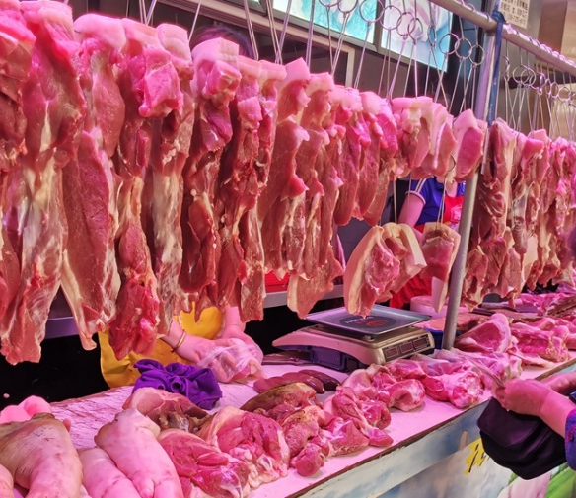
Recommendations
To optimize export performance, stakeholders should leverage advanced analytics and adapt strategies based on export trends and deviations.
Clustering analysis helps segment markets, while association rules provide insights for decision-making.
Machine learning models offer actionable insights to enhance trade strategies, improve market efficiency, and drive sustainable growth in the live pigs export sector.

Slide 21
Future Applications
The methodologies used in this project can be extended to other agricultural products,
Integrating real-time data sources can enhance market monitoring
The models can support supply chain optimization, policy impact analysis, and risk management.
The insights generated can inform strategic decision-making in multiple industries, including education, sustainability, and international trade.

Slide 22
Reference
Abdelbaki, W., Zreikat, A. I., Cina, E., Shdefat, A., & Saker, L. (2023). Crop prediction model using machine learning algorithms. Applied Sciences, 13(16), 9288. https://doi.org/10.3390/app13169288
Food and Agriculture Organization of the United Nations (FAO). (n.d.). FAOSTAT data. http://www.fao.org/faostat/en/#data
Kaggle. (n.d.). FAOSTAT: Food and agriculture data. https://www.kaggle.com/datasets/faoorg/faostat-food-and-agriculture-data

Slide 23
Thank You! Any Questions?

